Slide 1
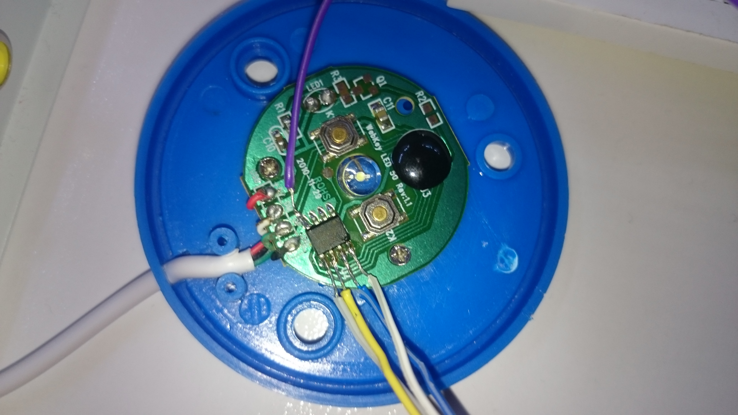
4- GND
5- SDA
6- SCL
8-VCC
7- WP

Slide 2
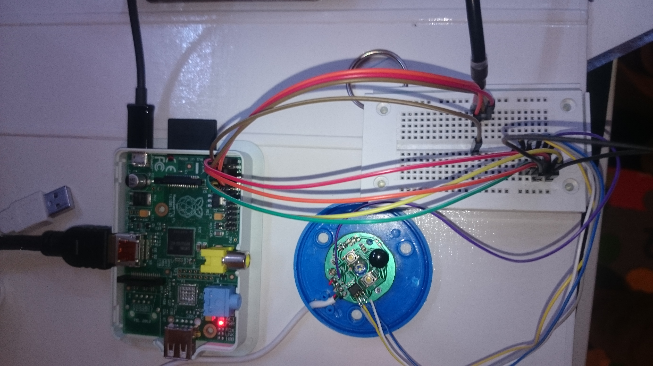
USB2Serial Adapter
UART-Interface
I2C-Interface + VCC
WebKey
Raspberry Pi Model A

